Slide 1
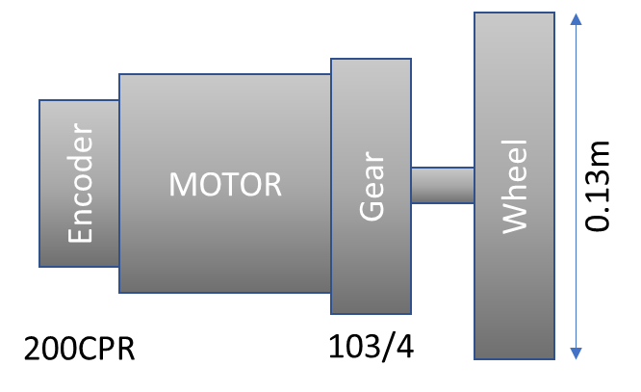
Motor1_setpoint
1
Motor1_PWM = MOTORS_PWM_STOP + PID_output1;
D
PID_output1 = PID_output1 + Motor1_PID.step(Motor1_setpoint, Motor1_feedback);
C
Motor1_PID.step(Motor1_setpoint, Motor1_feedback);
6
Proportional
PID_output1
Motor1_PWM
FILTER
3
4
5
-
Integral
+
+
+
PWM to Volt.
Derivative
MOTORS_PWM_STOP
A
B
E
DRIVE
2
Motor1_feedback

Slide 2
How 257.5 is calculated:
*
* encoder CPR: 200CPR (cycles per revolution in motor axel)
* gear ratio of motors: 103/4
* CPR_on_wheel (Resulting cycles per revolution in wheel axel): encoder CPR * gear ratio = 5150 cycles per revolution of wheel
*
* Motors_setpoint is measured in cycles of encoder per measuring time (20 miliseconds)
* period_ms = 20ms
*
* Diameter of wheel: 130mm = 13cm = 0.13m
* Perimeter_of_wheels_in_meters: Pi * Diameter = 0.4m
*
* 1 minute = 60000ms
*
* Speed_meters_per_minute = Linear_Velocity(m/s) * 60 seconds
* revolutions_per_minute = Speed_meters_per_minute / Perimeter_of_wheels_in_meters
* revolutions_per_ms = revolutions_per_minute / 60000ms
*
* Motors_setpoint = revolutions_per_ms * period_ms * CPR_on_wheel
*/
MOTOR
Encoder
Wheel
Gear
0.13m
200CPR
103/4
MOTOR
Encoder
Wheel
Gear
0.13m
200CPR
103/4

Slide 3
MOTORS_MaxLinear_Velocity (m/s)
MOTORS_MaxAngular_Velocity x 0,836875/12.875
0
MOTORS_MaxAngular_Velocity x 0,836875/12.875
-MOTORS_MaxAngular_Velocity (rad/s)
-MOTORS_MaxLinear_Velocity (m/s)
MOTORS_MaxAngular_Velocity (rad/s)

Slide 4




RS-232 (57.6 kBd; 8 data bits, no parity, 1 stop bit);
8C 22 0C AC xx
B9 EE F9 A9 D6
49 bits?
No empieza RS232 con high?
Debemos invertir?
Con movil da
07:46:A9:94:50:01:04:E0
Impreso: -7429-
Memoria: 1D:05

Slide 5
RS-232 (57.6 kBd; 8 data bits, no parity, 1 stop bit);
Original Data
7.4v
0v
-8.2v
Final Data
5v
0v
Byte 1
Byte 2
Byte 3
Byte 4
Byte 5

Slide 6
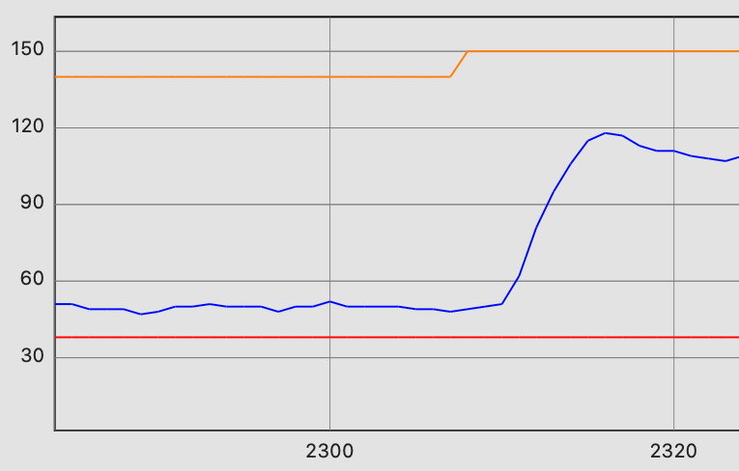
50ms
100ms
150ms

